Slide 1
Investigating the etiology of 'triploid mortality' within Pacific oysters: the contribution of marine heatwaves
NOAA Physiology Group Seminar
11/18/2021
Matthew George, Ph.D.

Slide 2
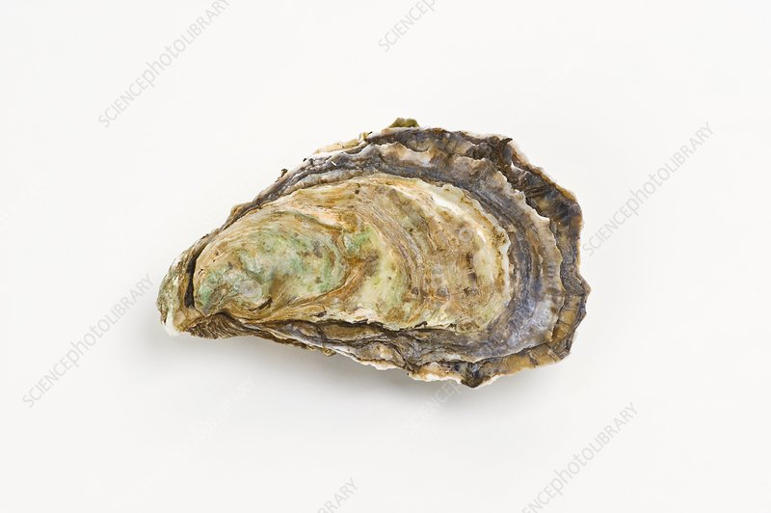

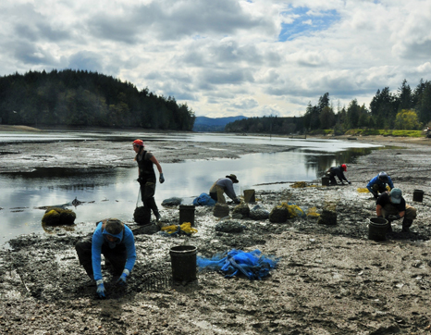
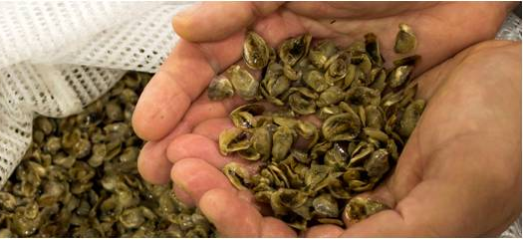
Pacific Oysters – tolerance is survival
Introduction
Pacific Oyster

Slide 3
Reproductive control in Pacific oysters
Introduction
Various methods used to induce triploidy (tetraploid cross, heat-shock, pressure, etc.) starting in the late 1970’s.
Triploid oysters have an extra chromosome set (3n).
Triploidy significantly reduces energetic investment in gonad production.
Triploid oysters have superior growth rates.
Harvesting triploids in the summer avoids the unpleasant taste of ‘spawny’ oysters.

Slide 4
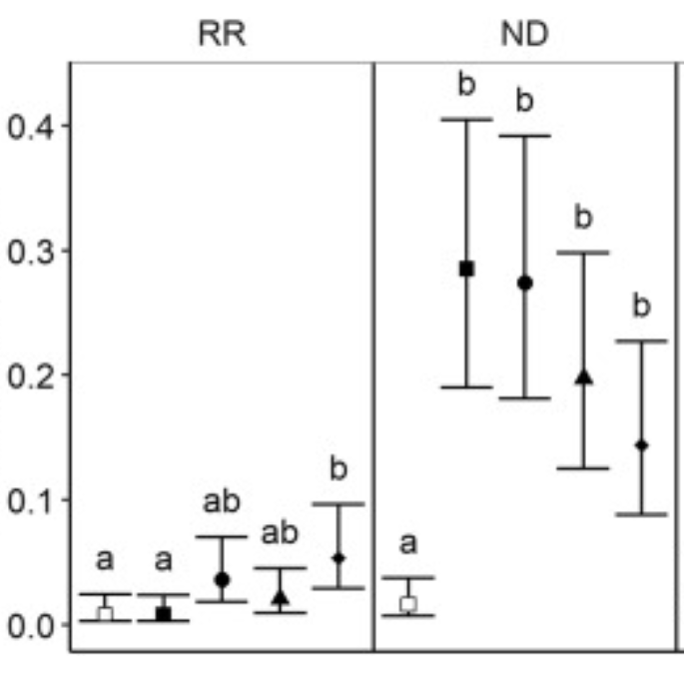
Diploid vs. Triploid mortality in the field
Introduction
Gulf of Mexico
Chesapeake Bay
Triploid
Cumulative mortality (%)
Probability of mortality
Field mortality extending through the summer
Diploid
Wadsworth 2018; http://hdl.handle.net/10415/6074
Matt et al. 2020; doi: 10.1016/j.aquaculture.2020.735375

Slide 5
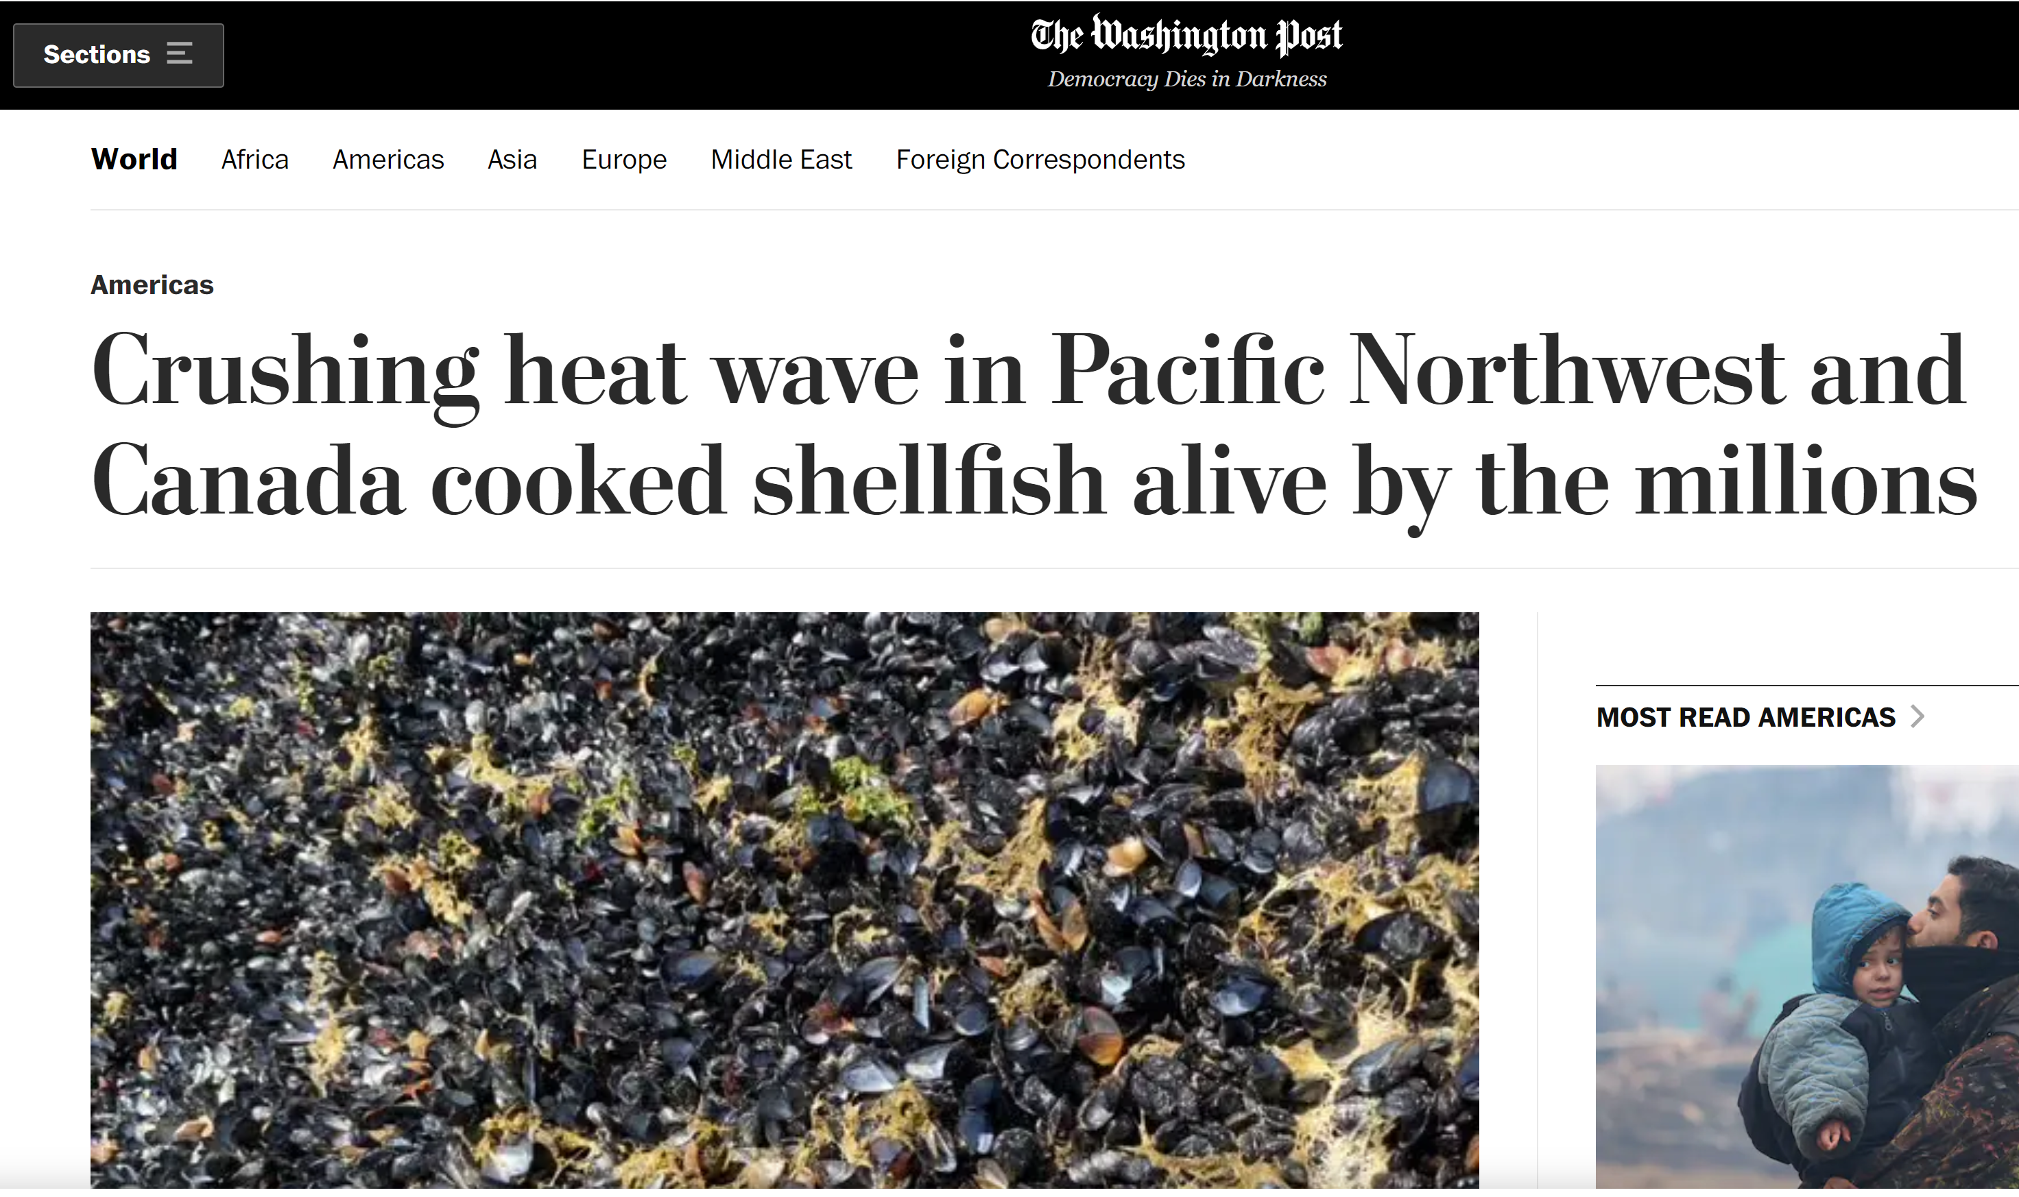
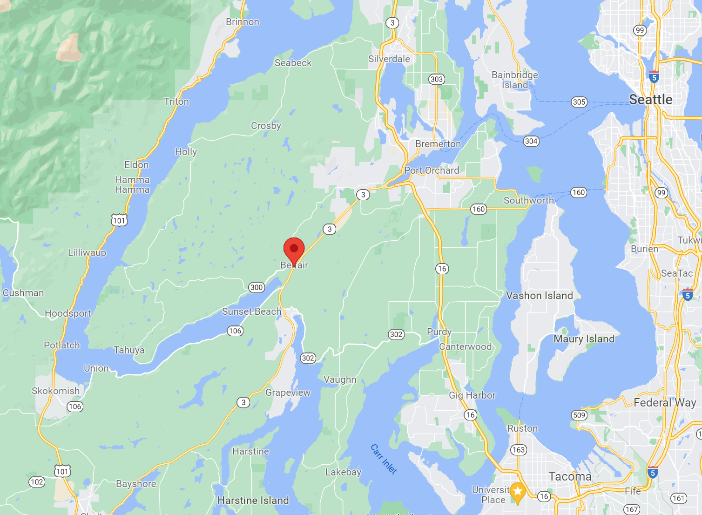
Marine Heatwaves
Introduction
June 2021
Air temp
40-45°
water temp
20-35°

Slide 6



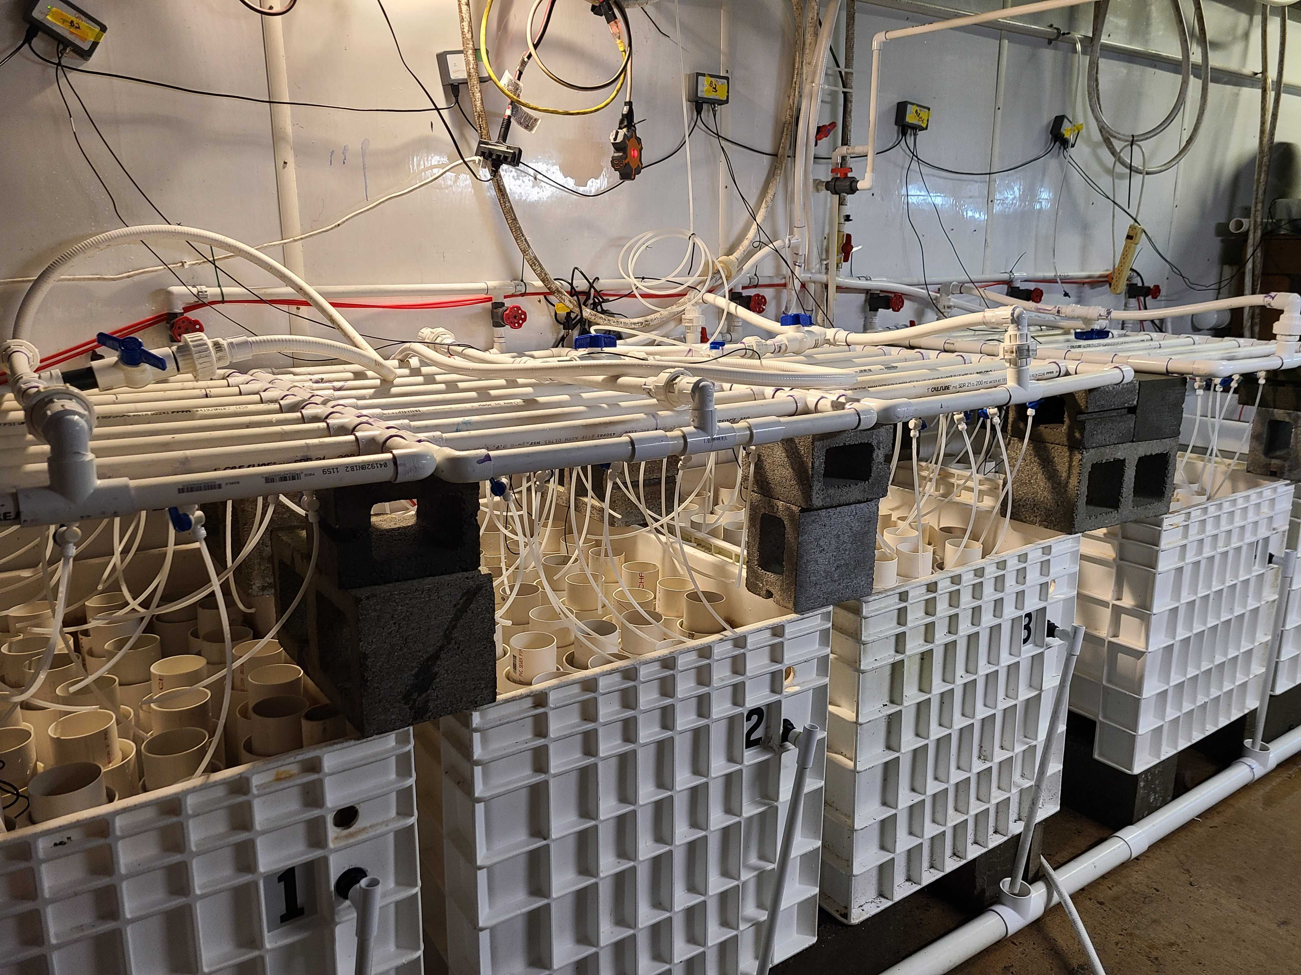
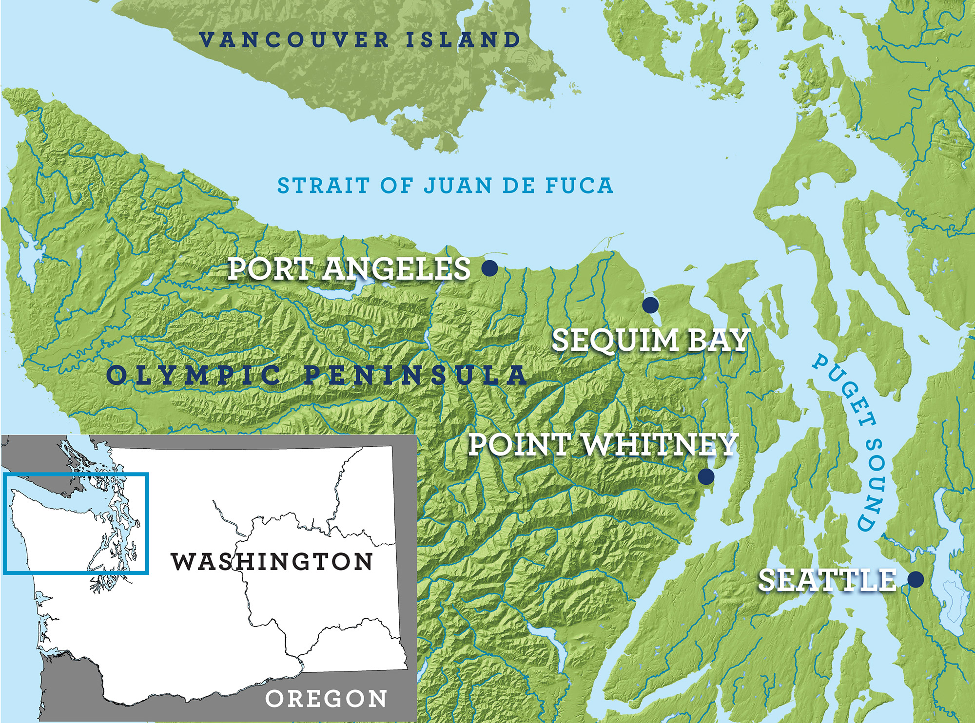
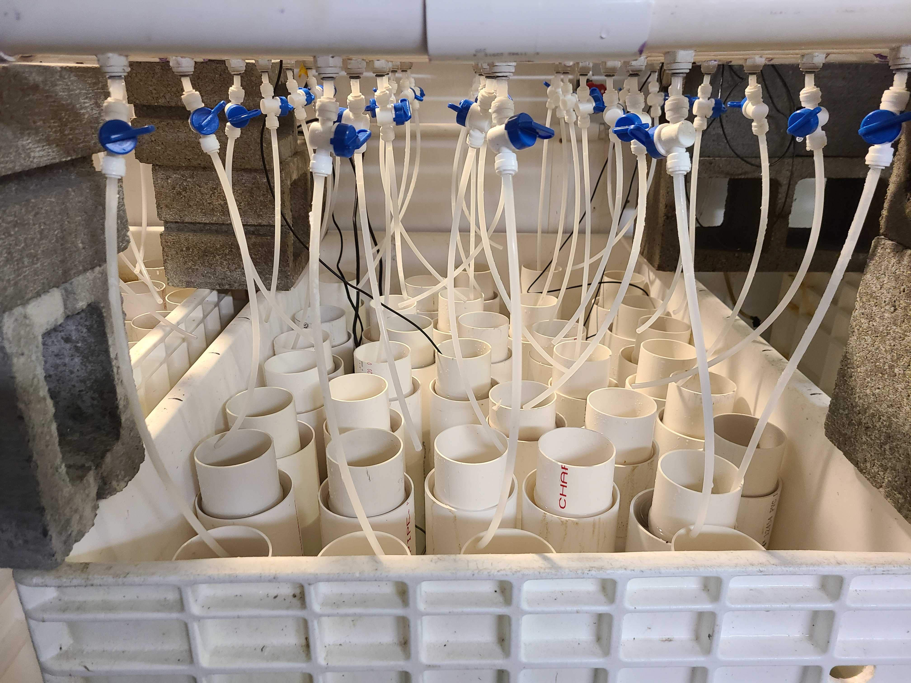
Point Whitney Shellfish Hatchery
Partners:

Slide 7
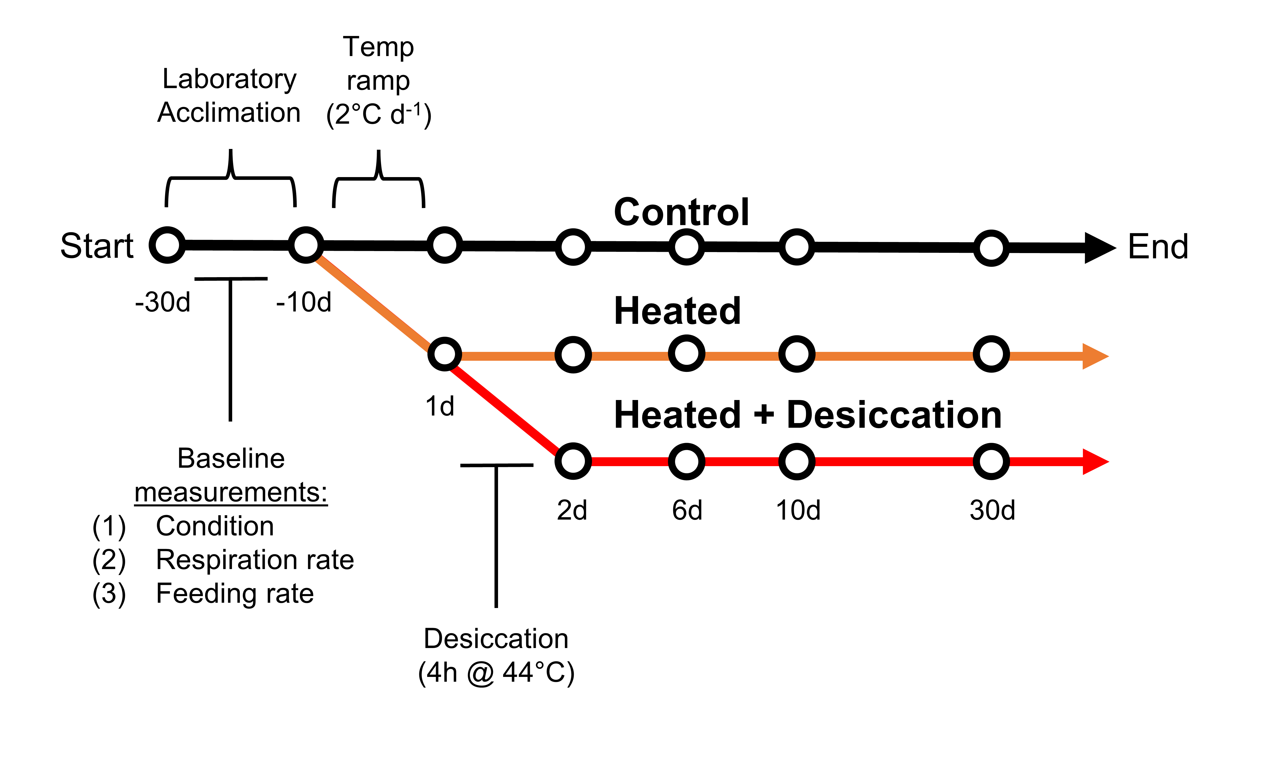
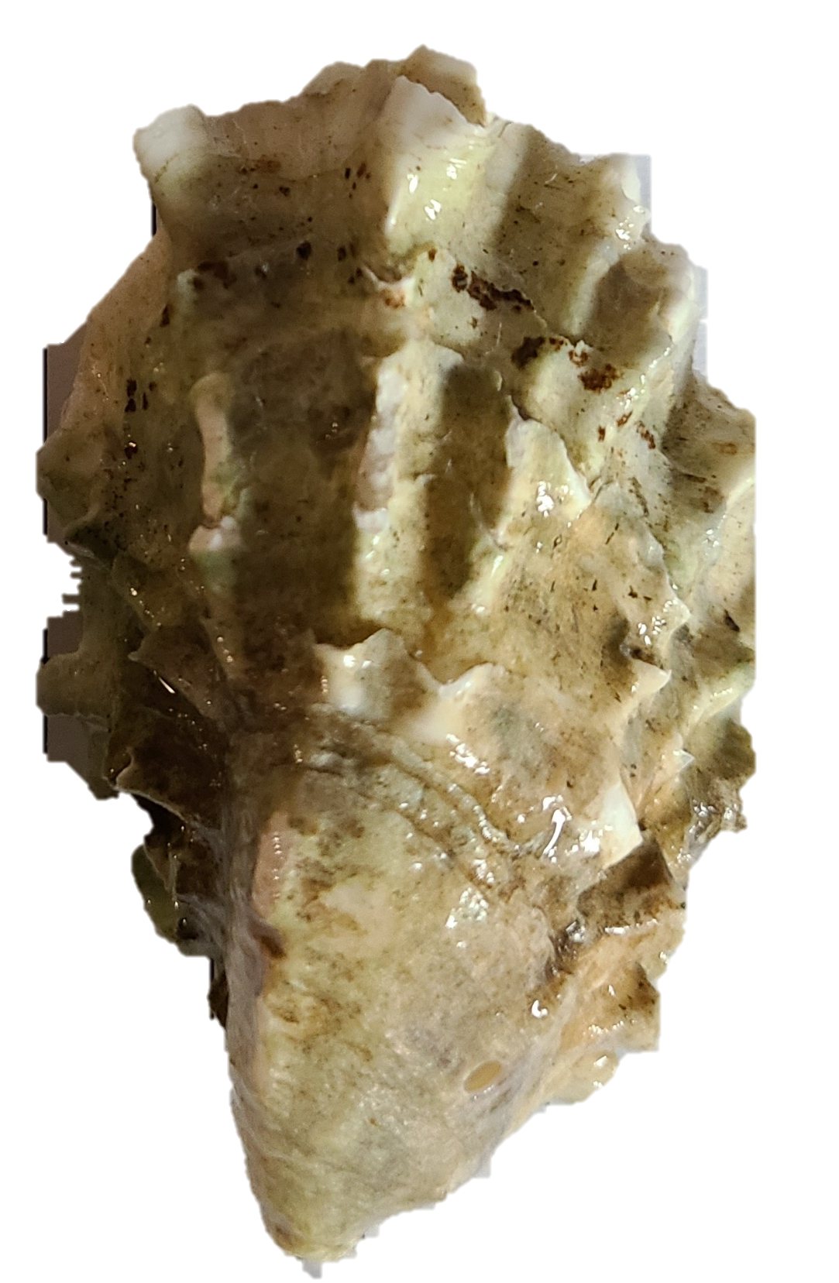
Experimental Design
Methods
(30°C)

Slide 8
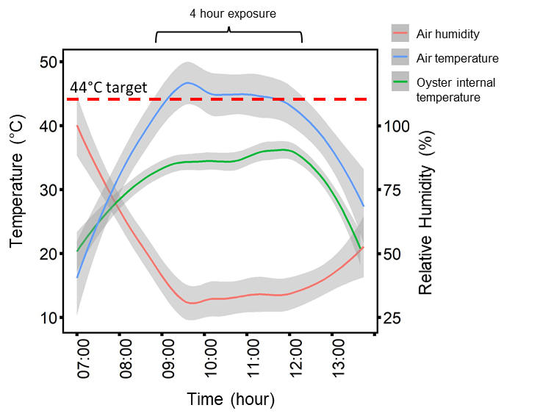
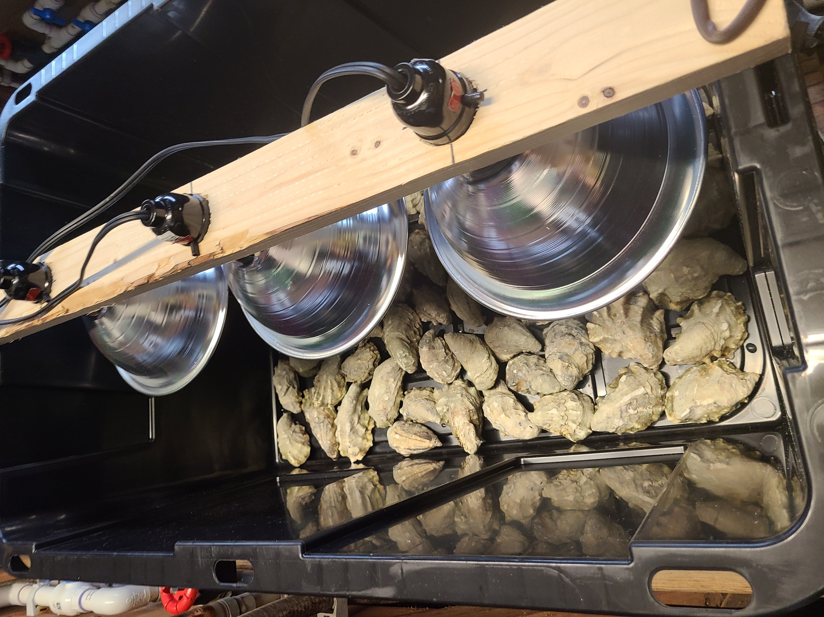
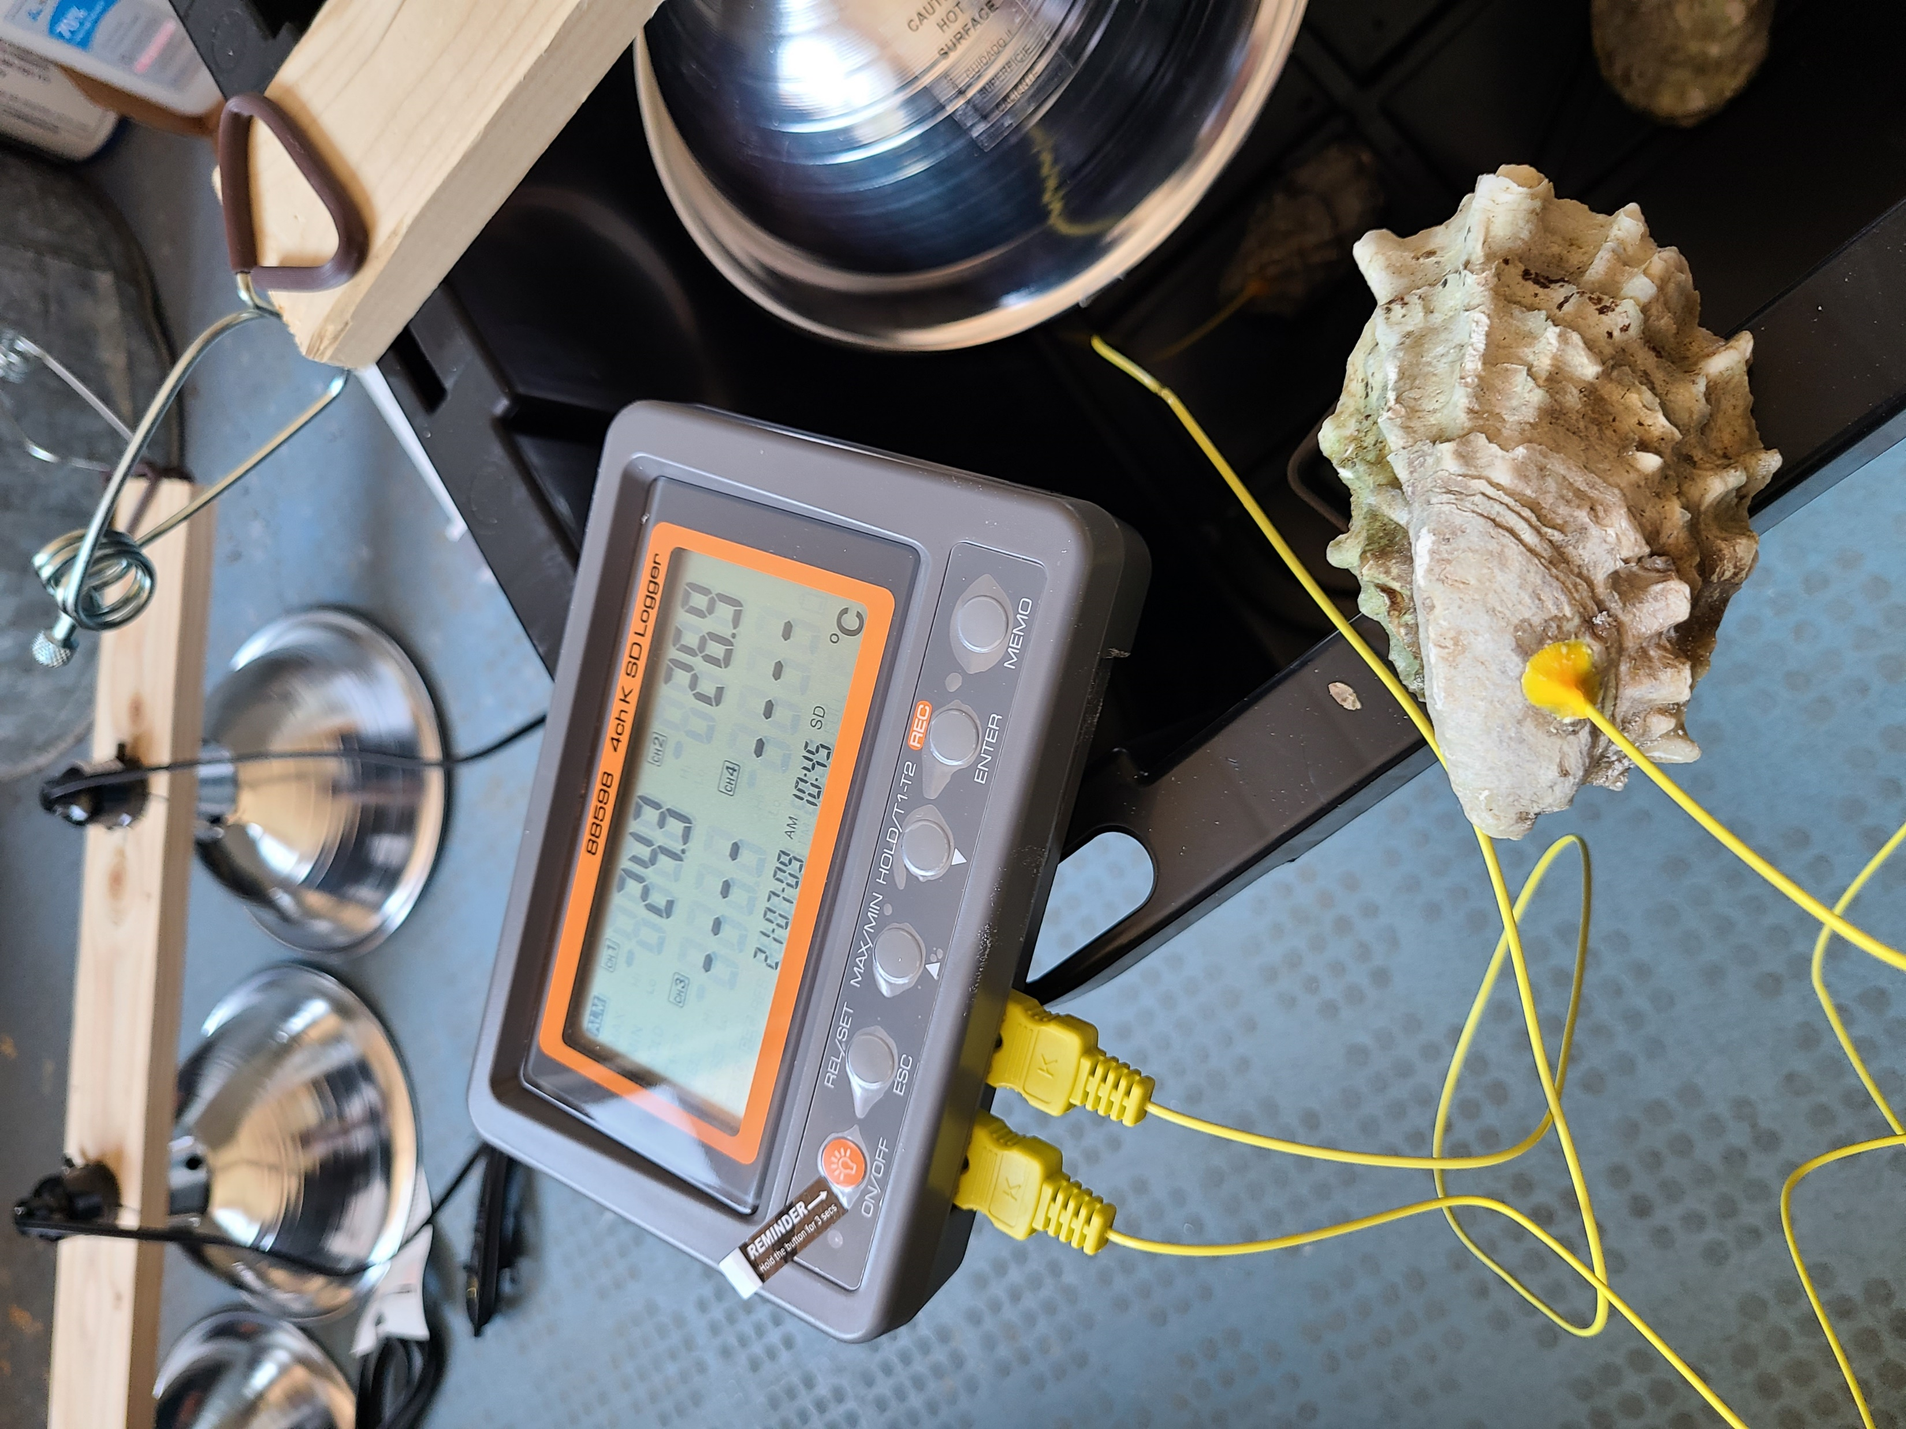
Desiccation
Methods

Slide 9
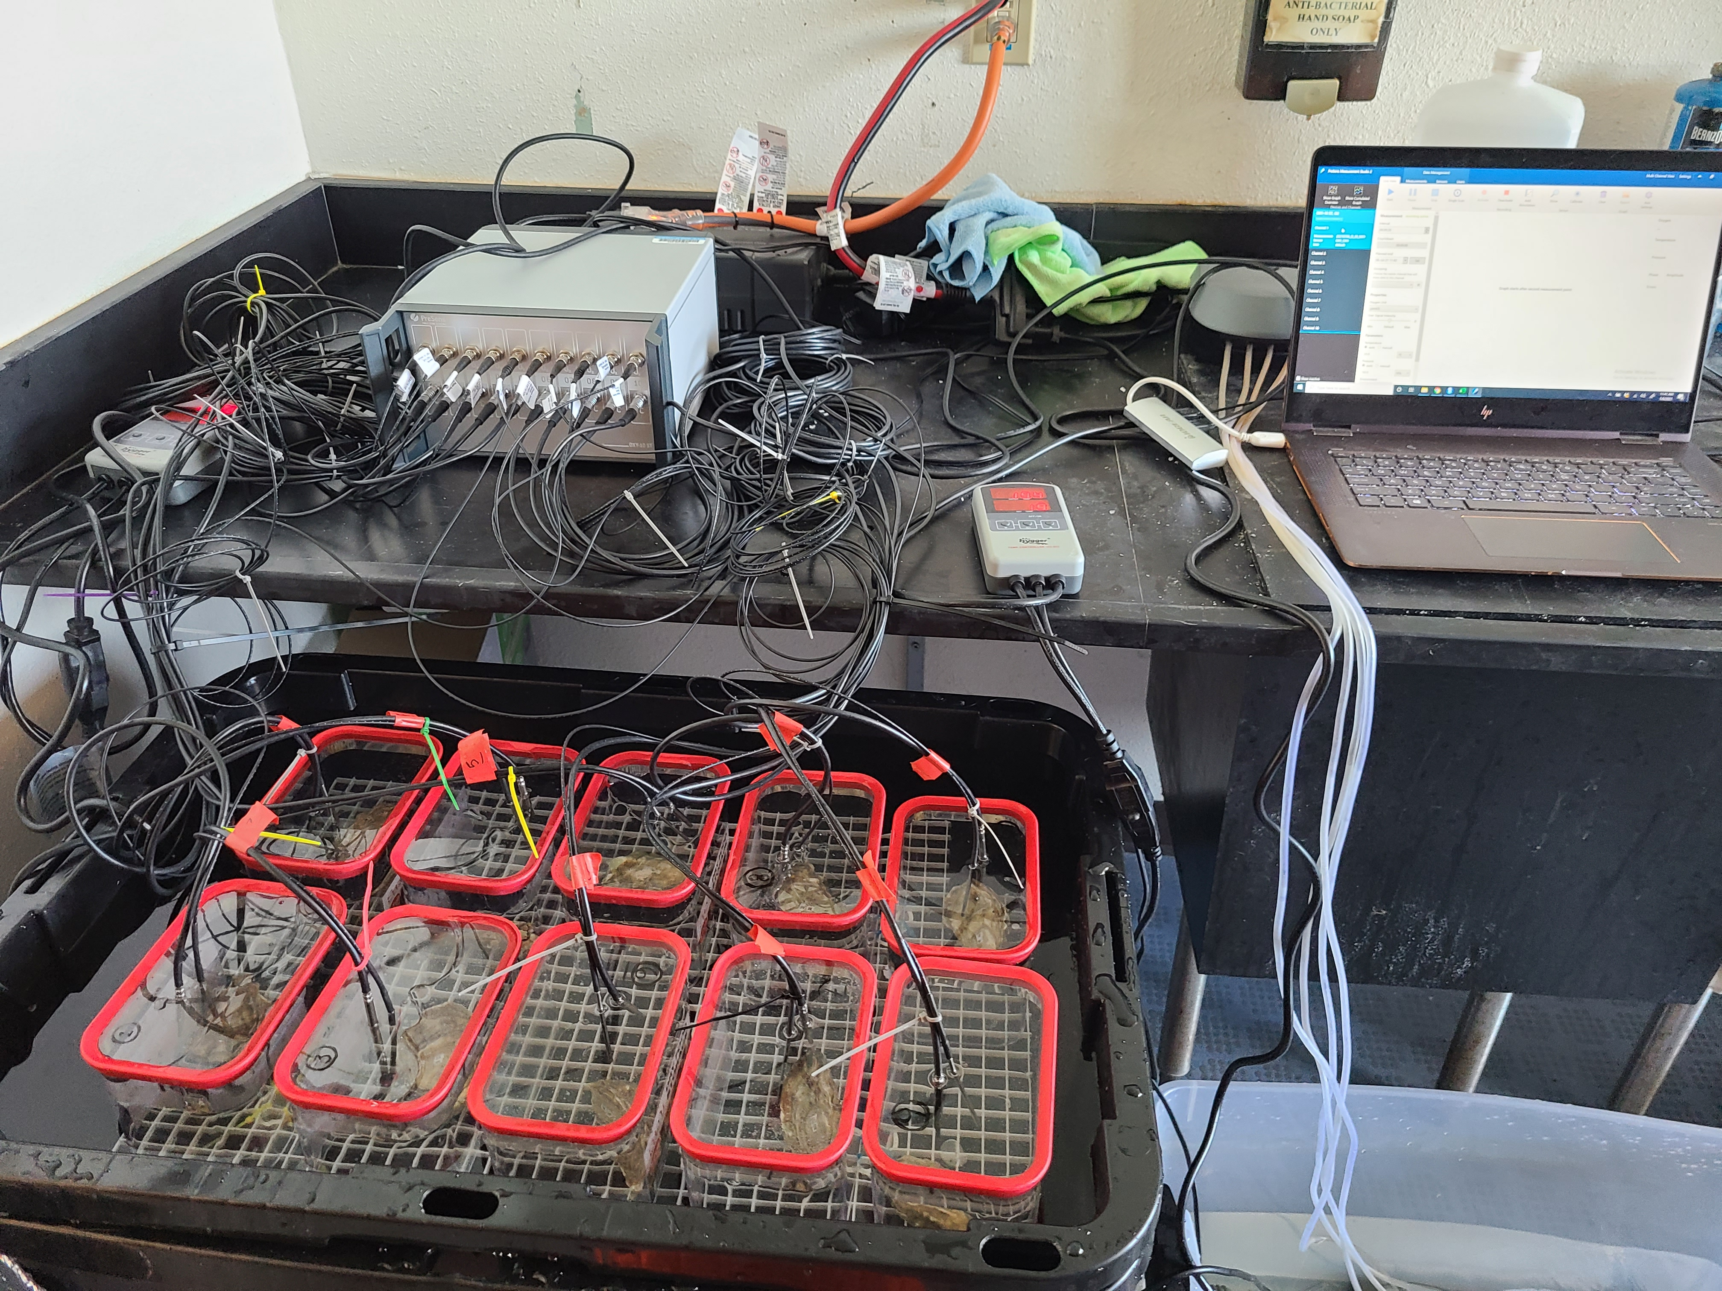
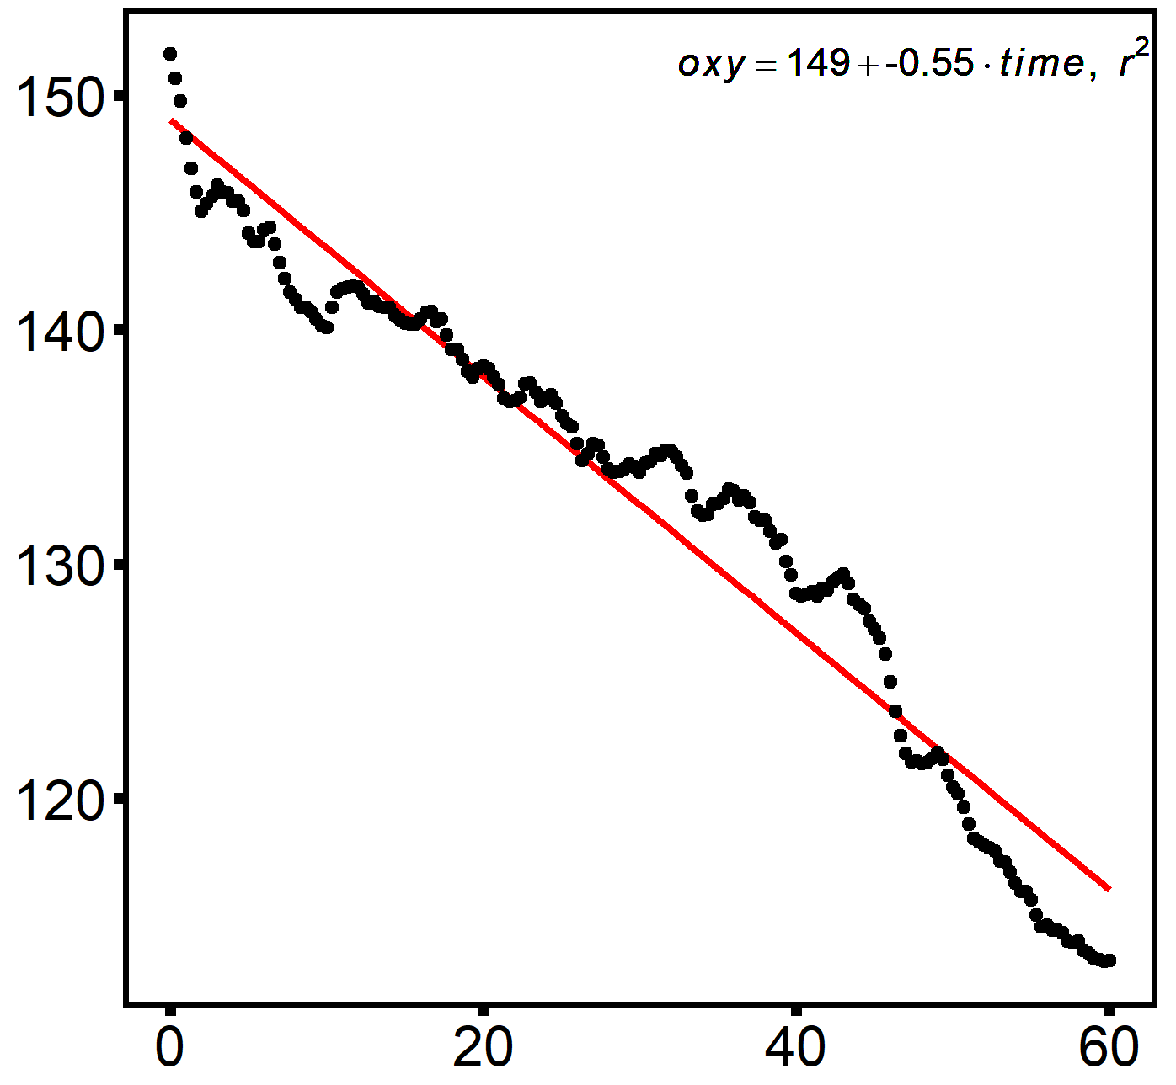
Respirometry
Methods
200
190
O₂ (µmol)
180
170
0
20
40
60
Time (min)

Slide 10

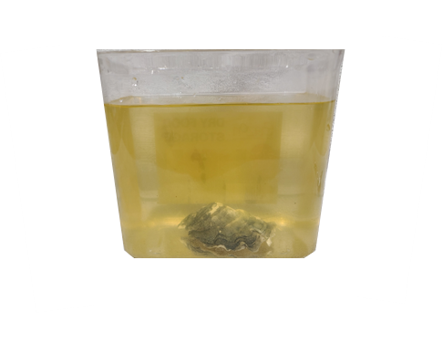
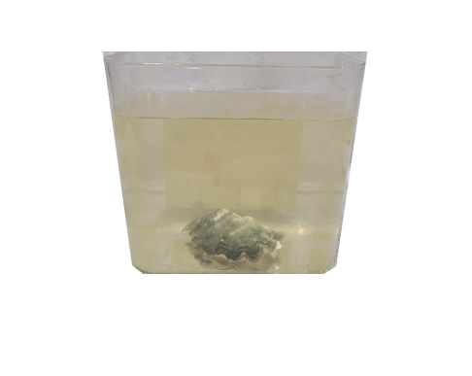
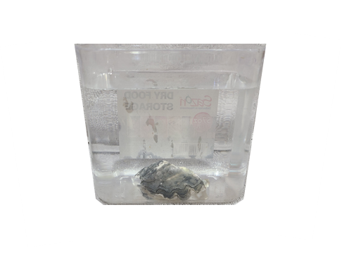

Clearance Rate
Methods
10⁶ cells ml⁻¹
10⁵ cells ml⁻¹
10² cells ml⁻¹
Clearance rate was defined as the amount of algae removed per unit time per oyster, corrected for oyster size

Slide 11
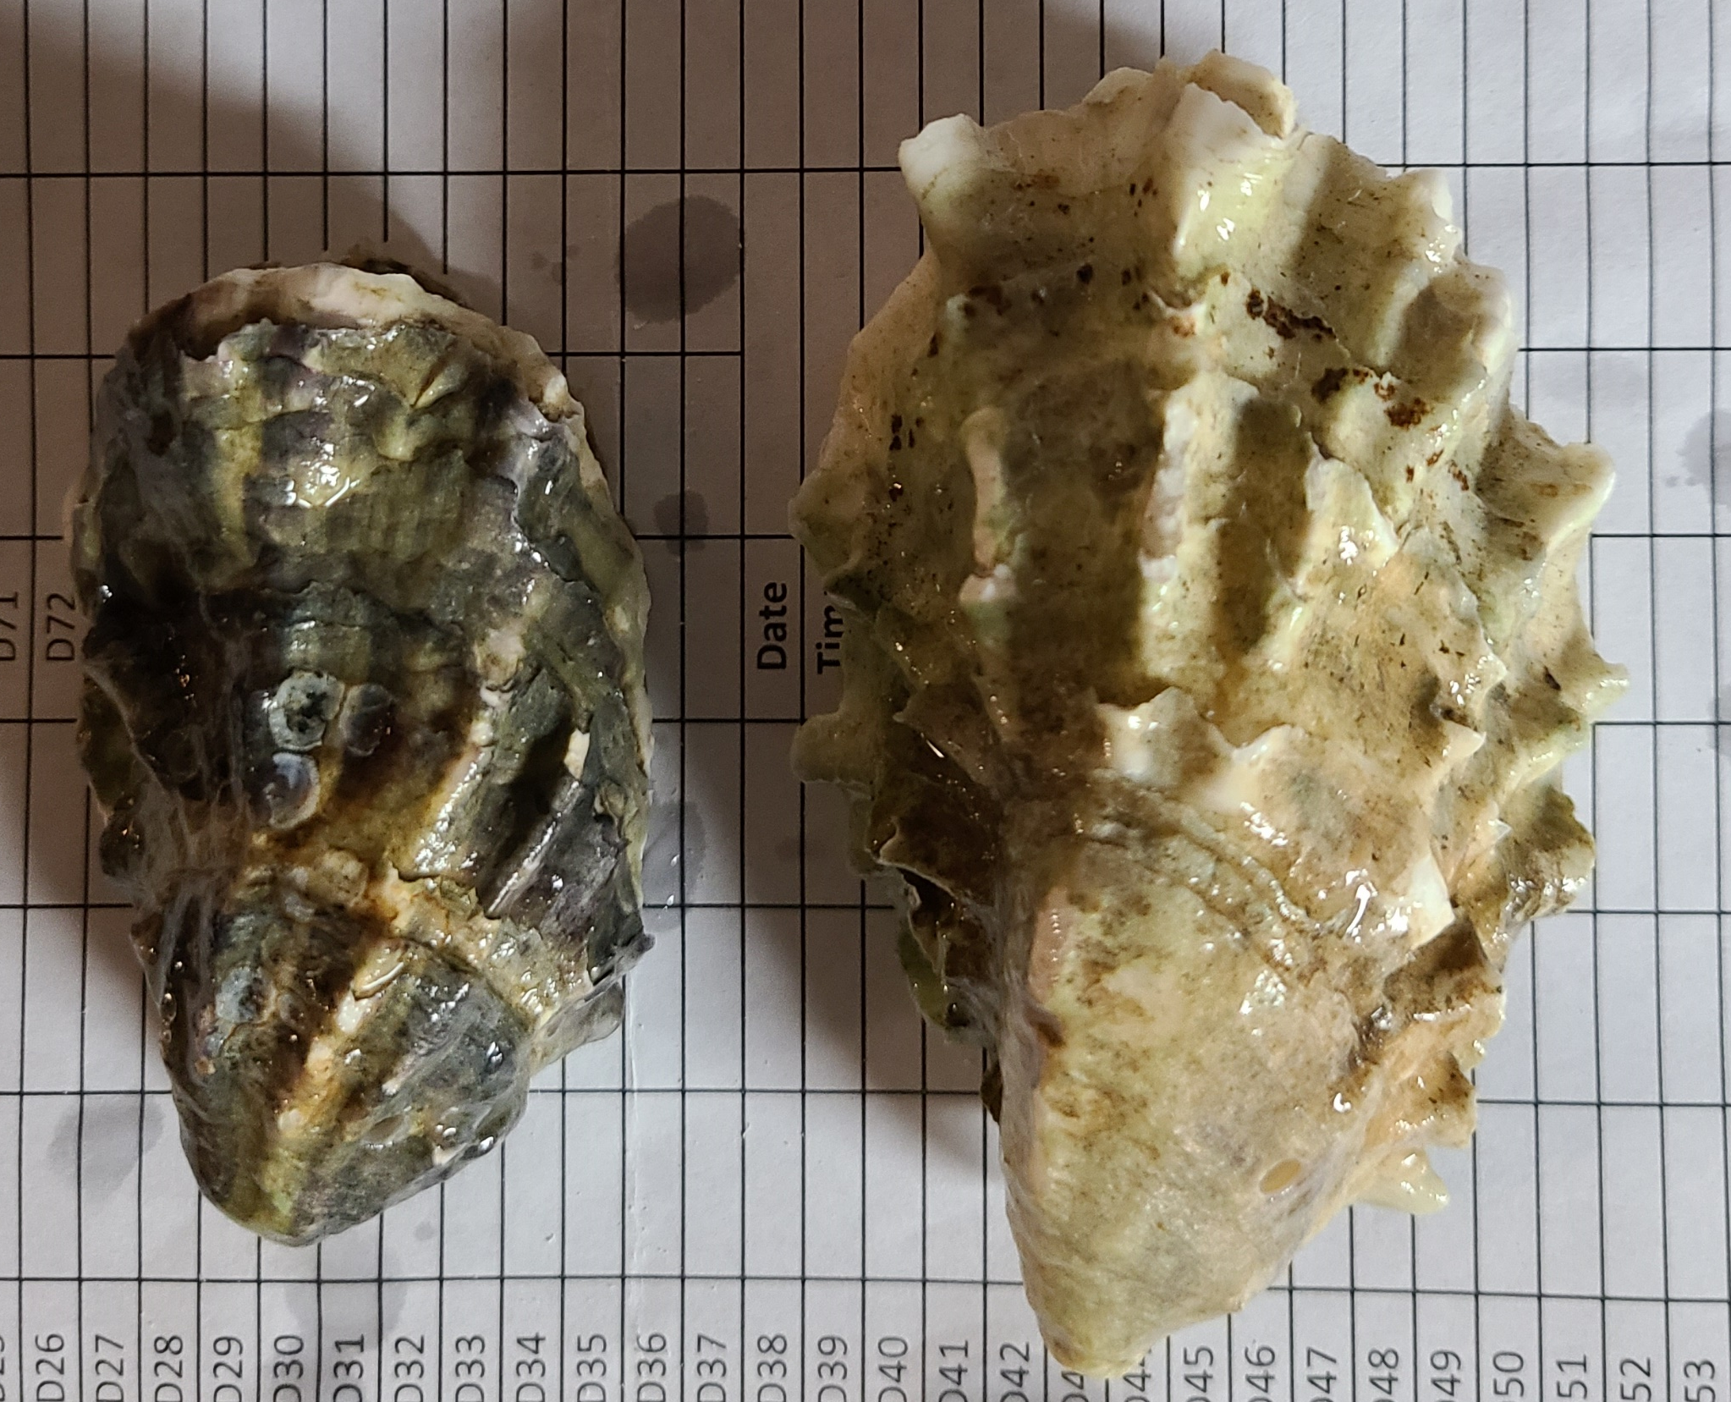
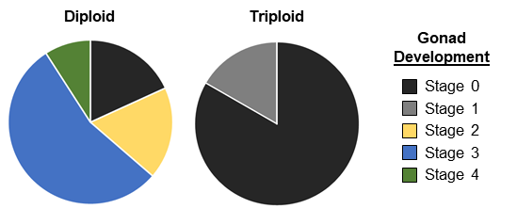
Reproductive Condition
Results

Slide 12
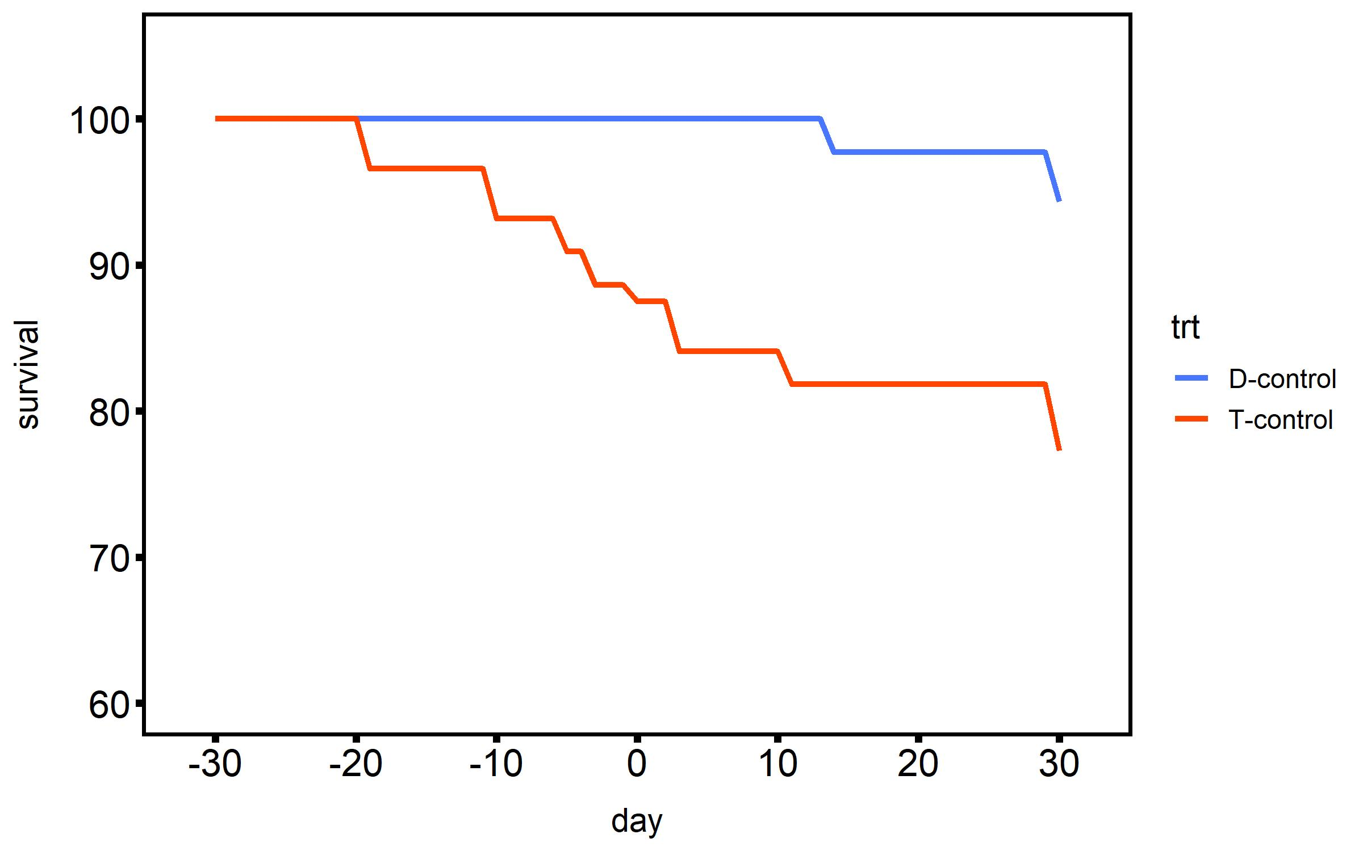
Mortality
Results
20°C
Treatment
2n - control
2n - heated
2n - heated +
desiccation
Survival (%)
3n - control
3n - heated
3n - heated +
desiccation
Timepoint (days heated)

Slide 13
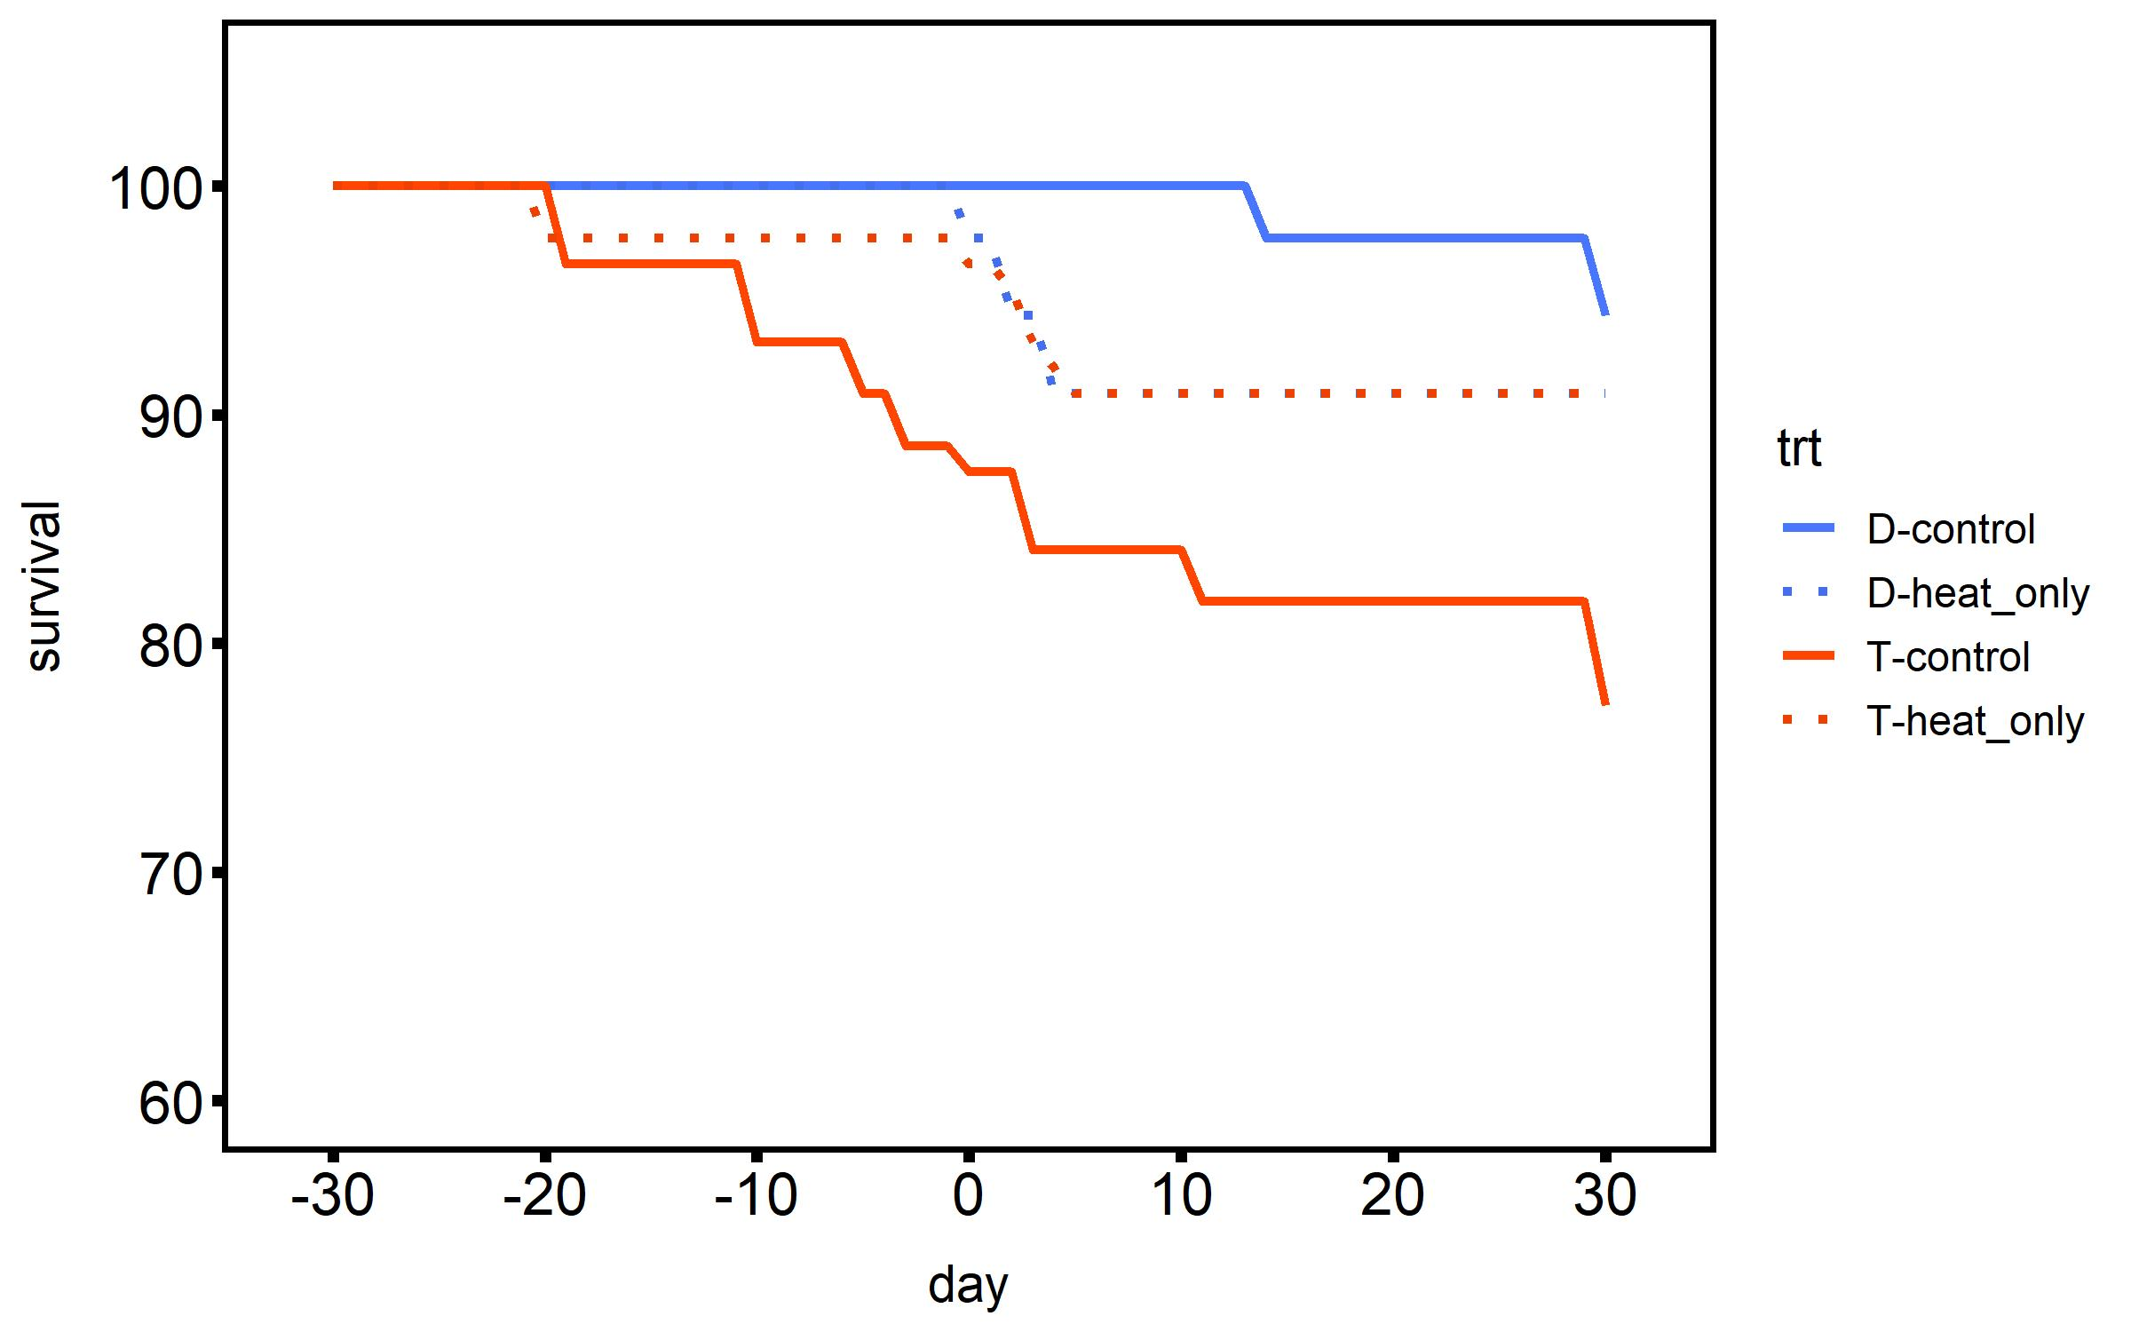
Mortality
Results
20°C
2°C d⁻¹ ramp
30°C
Treatment
2n - control
2n - heated
2n - heated +
desiccation
Survival (%)
3n - control
3n - heated
3n - heated +
desiccation
Timepoint (days heated)

Slide 14
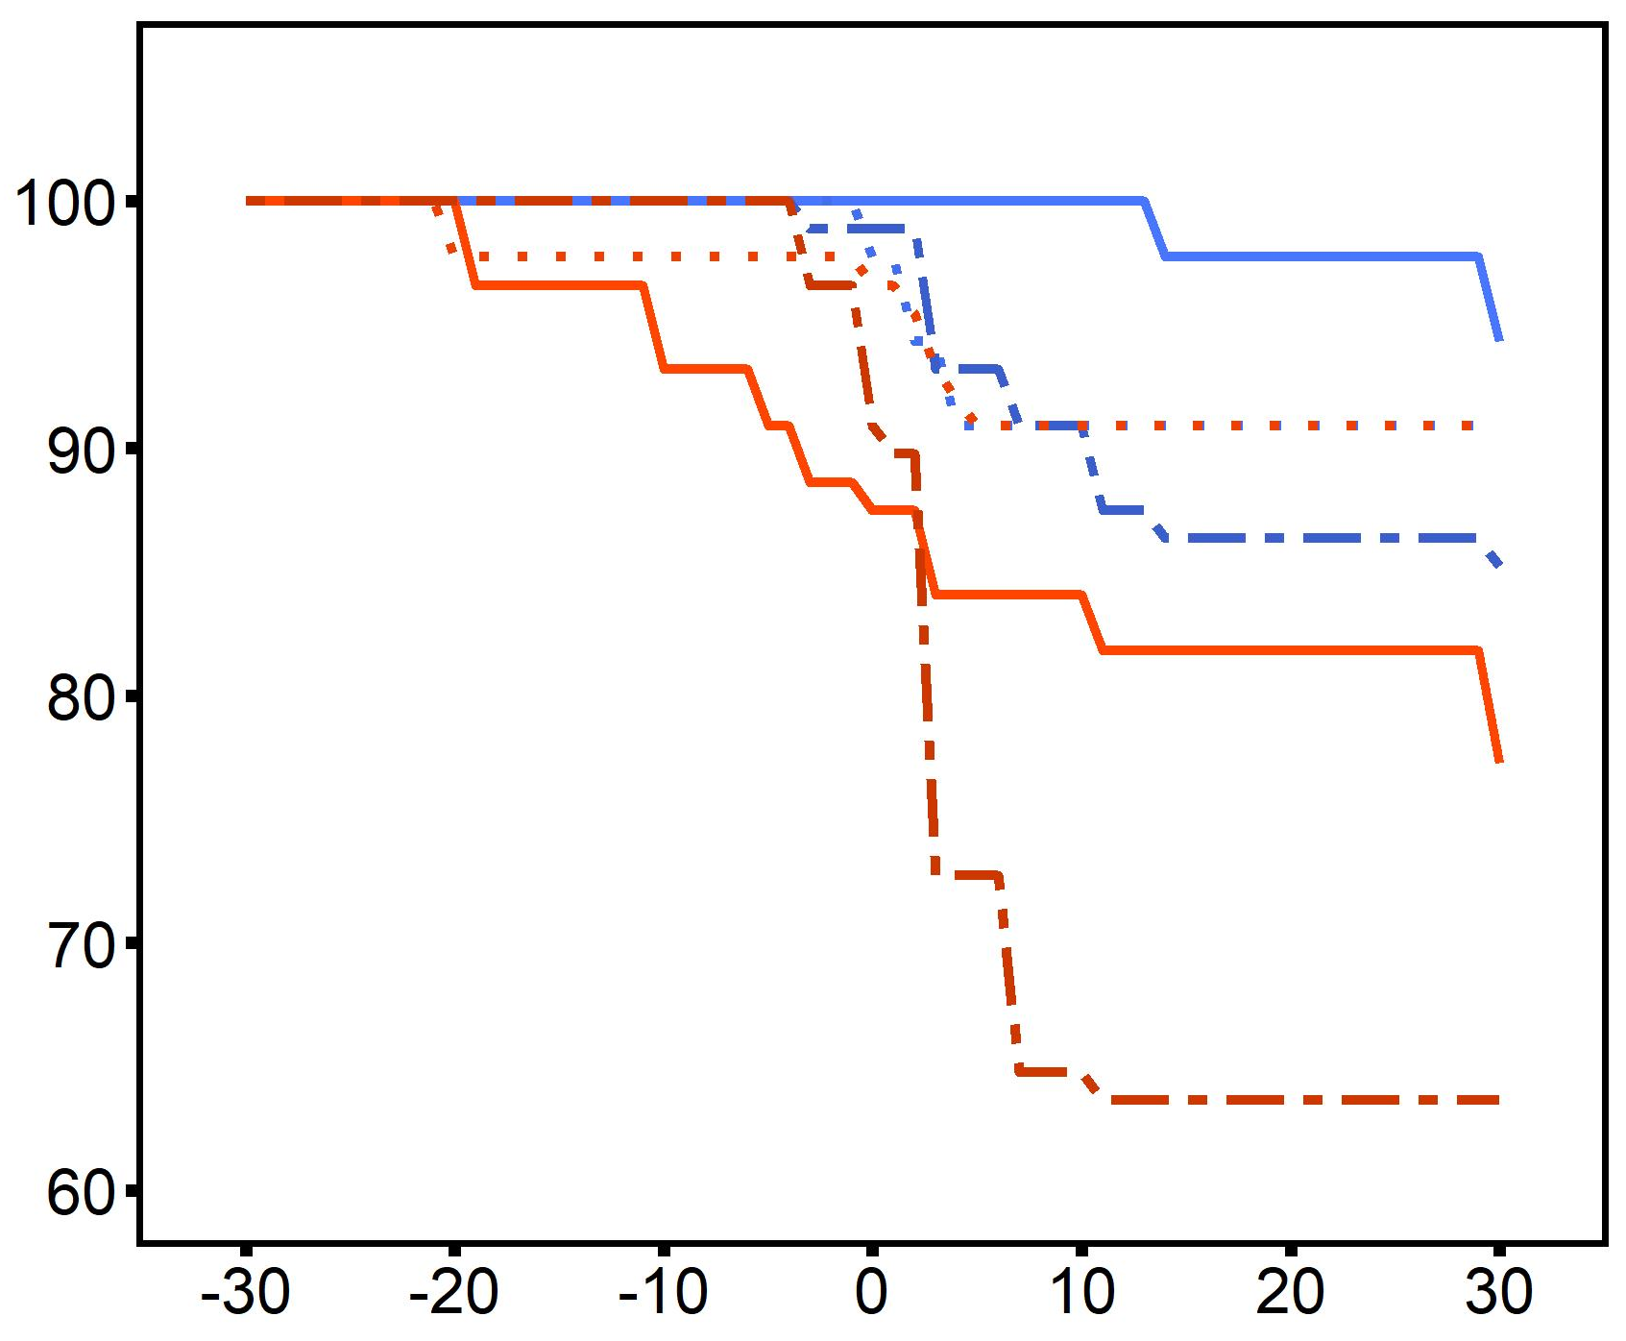
Mortality
Results
Desiccation
4 h @ 44°C
20°C
2°C d⁻¹ ramp
30°C
Treatment
2n - control
2n - heated
2n - heated +
desiccation
Survival (%)
3n - control
3n - heated
3n - heated +
desiccation
Timepoint (days heated)

Slide 15
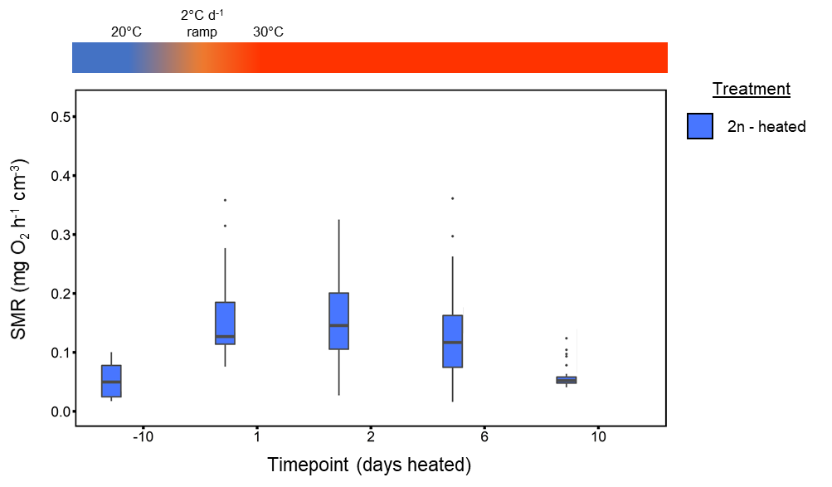
Metabolic Rate
Results
control

Slide 16
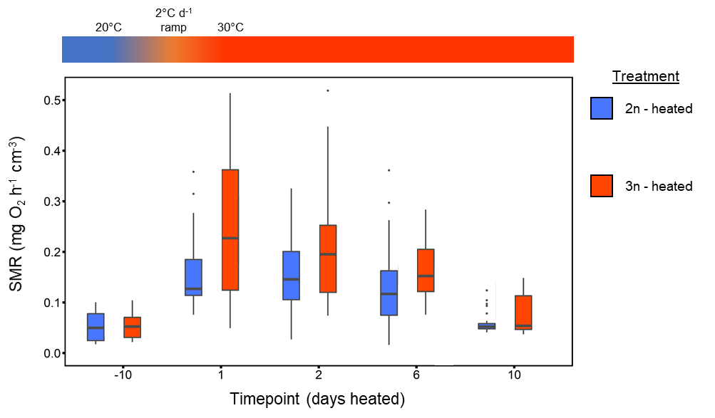
Metabolic Rate
Results
control

Slide 17
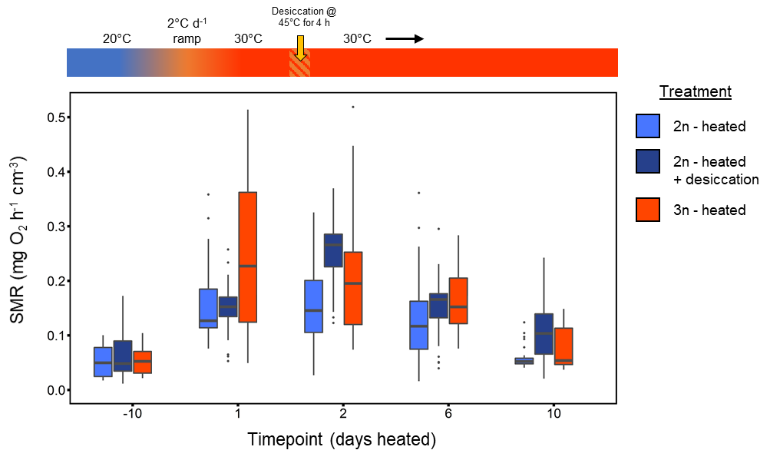
Metabolic Rate
Results
control

Slide 18
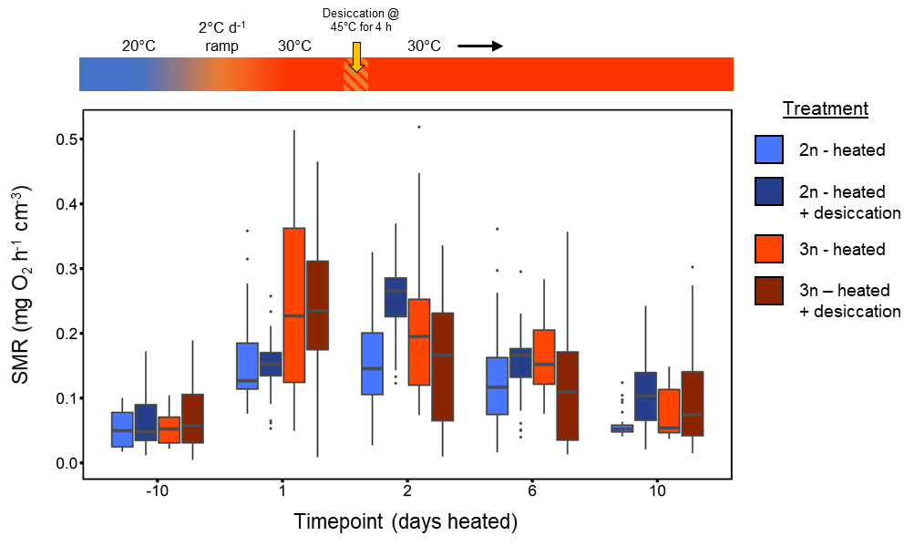
Metabolic Rate
Results
ploidy: p=0.003
time: p<0.001
ploidy×time: p=0.03
control

Slide 19
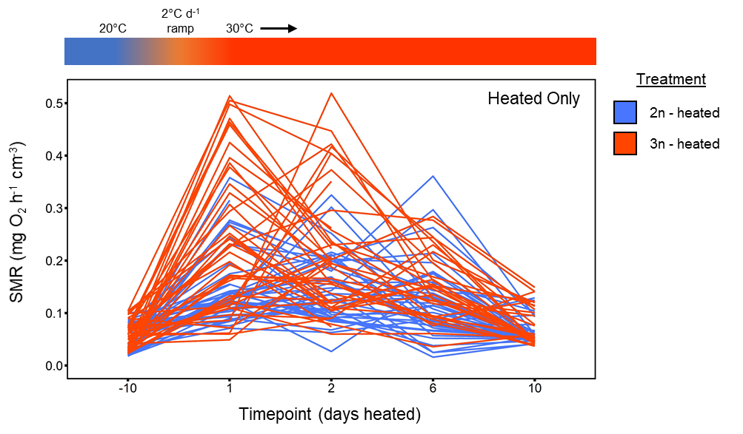
Heated
Results
control

Slide 20
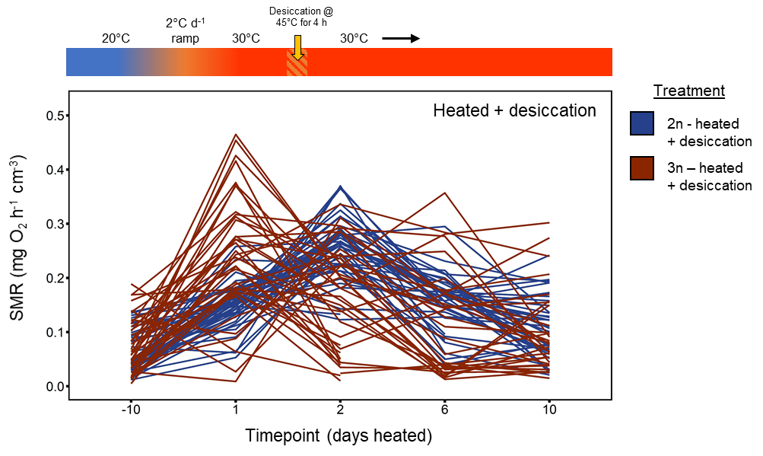
Heat + Desiccation
Results
control

Slide 21
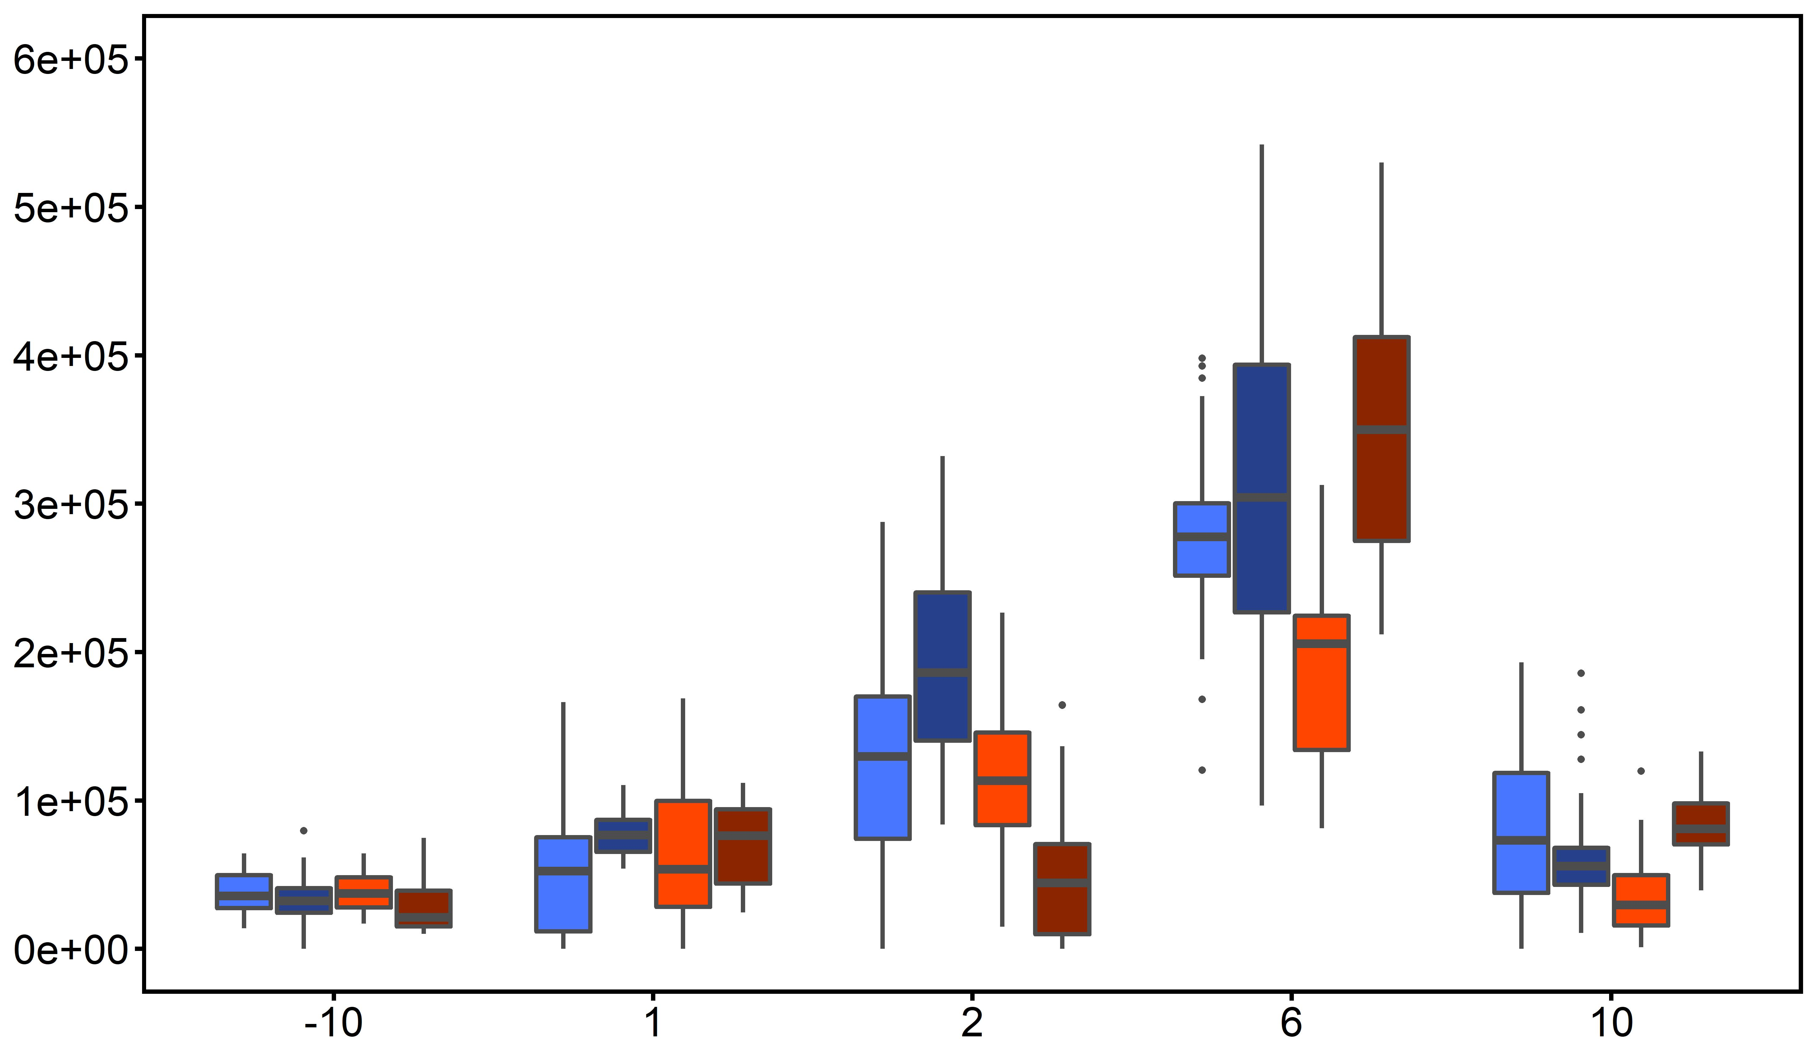
Clearance Rate
Results
ploidy: p<0.001
time: p<0.001
ploidy×time: p<0.001
Clearance Rate (cells ml⁻¹ h⁻¹ cm⁻¹)
control
Timepoint (days heated)

Slide 22
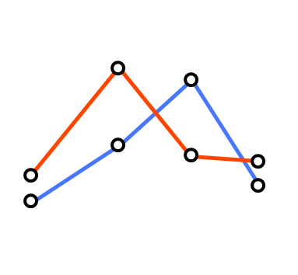

Summary
Results
Metabolism
Feeding
2n
3n
response
time
Recovery
Recovery
primary stressor
primary stressor
secondary stressor
secondary stressor

Slide 23
Conclusions
Conclusions
Heat stress alone didn’t result in mortality.
Multiple stressors (heat + desiccation) resulted in triploid mortality, although not at levels observed in the field.
Triploids underwent metabolic depression after multiple stress exposure
Triploids exhibit depressed feeding rates immediately after stress exposure.

Slide 24
Next Steps
Conclusions
Gene expression – Tag-seq to identify differential gene expression.
Citrate synthase activity – quantitative enzyme marker for the presence of intact mitochondria, aerobic capacity.
ATPase Enzyme activity – ability to pump ions could account for up to 40% of metabolic rate

Slide 25

Partners & Funding Sources

Slide 26
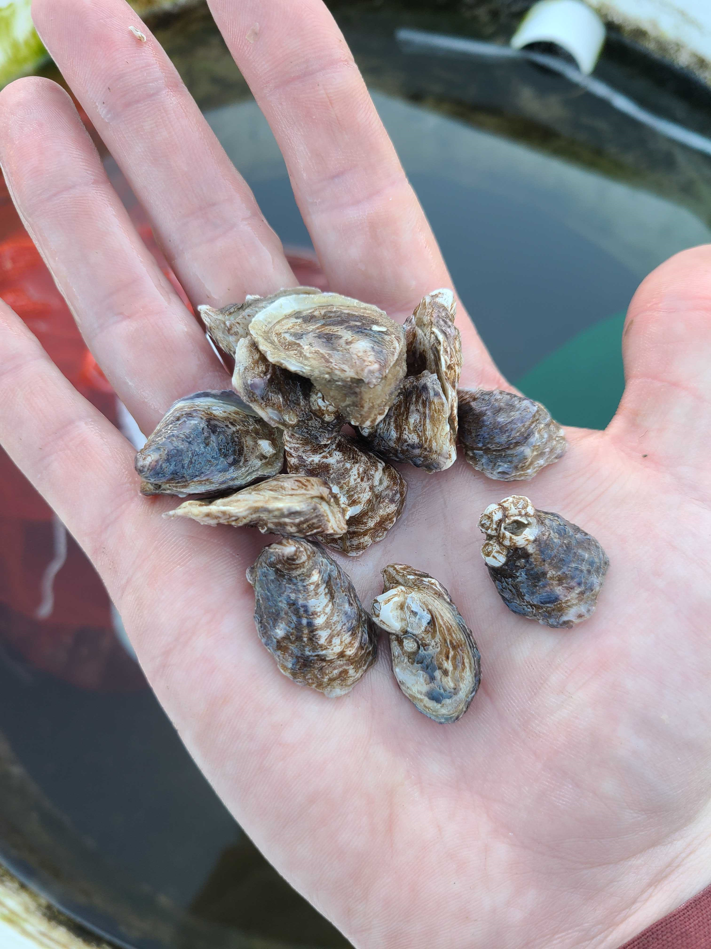

Questions?

